Slide 1

AUTOMOBILE ENGINEERING FINAL YEAR PROJECT
ON
PREPARATION, CHARACTERISATION AND ENGINE PERFORMANCE EVALUATION WITH BLENDS OF BIO-DIESEL USING WASTE COOKING OIL
PRESENTED
BY
NAME OF STUDENT UNIVERSITY ROLL NO.
PRATYAY GHOSH 11603219009
SOUHARDIK KUNDU 11603219005
DIPESH MAITI 11603219007
LYTZA CHATTERJEE 11603219020

Slide 2

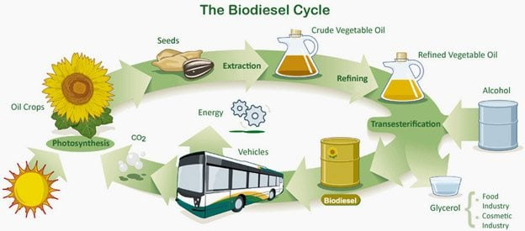
INTRODUCTION
WHAT IS BIO-DIESEL?
Biodiesel refers to a non-petroleum-based diesel fuel consisting of short chain alkyl (methyl or ethyl) esters, made by Transesterification of vegetable oil or animal fat (tallow), which can be used (alone, or blended with conventional Petro diesel) in unmodified diesel-engine vehicles.
BIO-DIESEL CYCLE :-

Slide 3
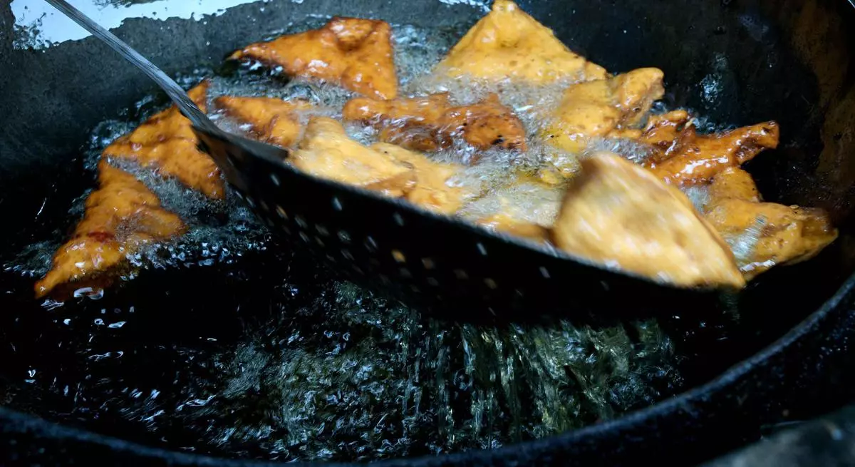
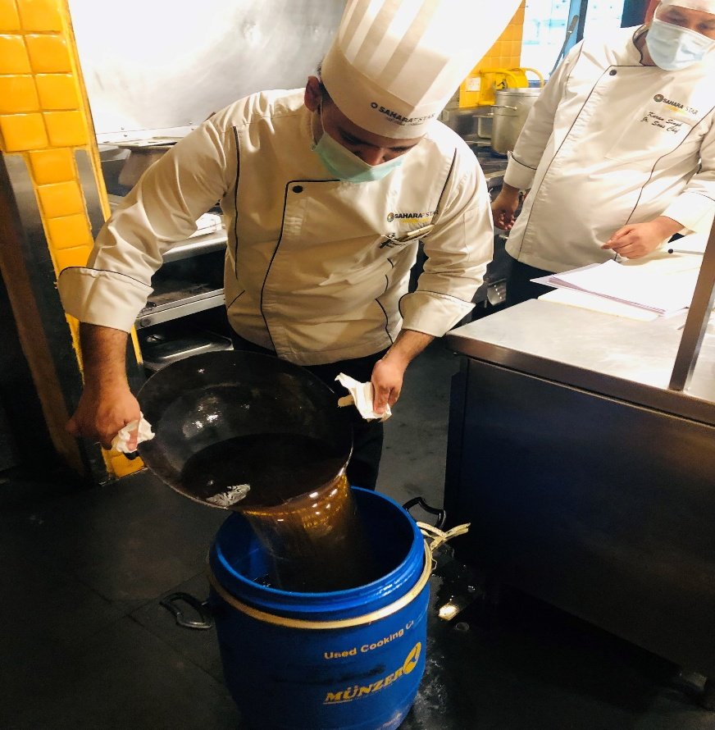
SCENARIO OF WASTE COOKING OIL IN INDIA
The Food Safety and Standards Authority of India(fssai) estimates that the amount of Waste Cooking Oil produced in India is around 3 million metric tons annually .The majority of spent cooking oil from houses is disposed of in the drainage and soil or returns to the food chain. Thus, one recommendation to overcome these issues is to utilize the Waste Cooking Oil as raw materials for biodiesel which is more economical and environment friendly.

Slide 4
SELECTION OF OIL
We have selected Waste Palm oil as our subject of interest.
India is the world’s second largest consumer of Palm oil and also the world’s largest importer (10
million tonnes imported in the year 2018). Due to the low price of palm oil, it is popular among
India’s poorer citizens for household cooking.
Due to the high availability and less cost, palm oil is used widely in restaurants, cafes and is a popular choice among local vendors. As a result a large amount of waste palm oil is generated everyday.
OIL | 2019 | 2020 | 2021 | 2022
PALM | 76 | 90 | 140 | 160
VANASPATI | 70 | 100 | 140 | 170
MUSTARD | 100 | 120 | 160 | 200
SOYBEAN | 85 | 90 | 155 | 190
SUNFLOWER | 100 | 110 | 145 | 192
GROUND-NUT | 140 | 143 | 180 | 190
PRICES OF EDIBLE OIL IN INDIA (VALUES IN RS/Kg).

Slide 5
LITERATURE REVIEW
S.L.Sinha And R.K.Yadav (2010) investigated, the bio-diesel produced from the jatropha seeds have been considered as a potential alternative for running the compression ignition engines. The different blends of bio-diesel and conventional diesel have been tested on the engine. It has been observed that 20% of jatropha oil can be substituted for diesel without any engine modification and preheating of the blends. The level of hydrocarbon emission and noise level have been found to be reduced with the use of more bio-diesel content.
G Lakshmi Narayana Rao ,S Sampath, and K Rajagopal (2008);Transesterified vegetable oils (biodiesel) are promising alternative fuel for diesel engines. Used vegetable oils are disposed from restaurants in large quantities. But higher viscosity restricts their direct use in diesel engines. In this study, used cooking oil was dehydrated and then transesterified using an alkaline catalyst. The combustion, performance and emission characteristics of Used Cooking oil Methyl Ester (UCME) and its blends with diesel oil are analyzed in a direct injection C.I. engine. The fuel properties and the combustion characteristics of UCME are found to be similar to those of diesel. A minor decrease in thermal efficiency with significant improvement in reduction of particulates, carbon monoxide and unburnt hydrocarbons is observed compared to diesel.

Slide 6
LITERATURE REVIEW
V P Sethi, K S Salariya (2004) research on a 4-stroke 5 hp diesel engine was tested with two different fuel blends. In the first case, diesel kerosene blends (with 10% to 40% kerosene blending by volume) and in the second case, air-liquefied petroleum gas (LPG) mixture (15% to 25 % LPG mixing by volume) along with diesel was tested at constant engine speed of 1700 rpm. Different engine exhaust emissions CO2 , CO, HC,SO2, NOx were compared using pure diesel, diesel-kerosene blends and air-LPG mixtures.
N.R. Banapurmatha A, P.G. Tewaria A, R.S. Hosmath B (2008) described the best way to use vegetable oils as fuel in compression ignition (CI) engines is to convert it into bio-diesel. Biodiesel can be used in CI engines with very little or no engine modifications. This is because it has properties similar to mineral diesel. They presents the results of investigations carried out on a single-cylinder, four stroke, direct-injection, CI engine operated with methyl esters of Honge oil, Jatropha oil and sesame oil. Comparative measures of brake thermal efficiency, smoke opacity, HC, CO, NOX, ignition delay, combustion duration and heat release rates have been presented and discussed.

Slide 7
SCOPE OF THE WORK
Feasibility study about production and utilization of Bio fuels in automotive sector.
Biodiesel production in a lab from waste cooking oil(Palm oil) and testing its chemical properties.
Blending biodiesel with diesel in different proportions to analyse the cost effectiveness.
Using the blended diesel in a 4Stroke Diesel Engine to measure the Brake Power(BP), Brake specific fuel consumption(BSFC), Fuel consumption(FC) and exhaust gas temperature.

Slide 8
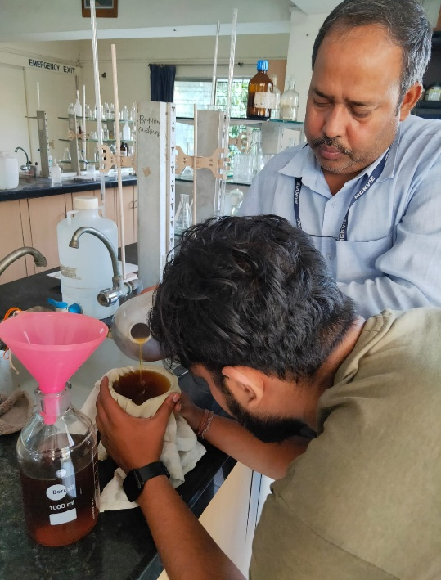
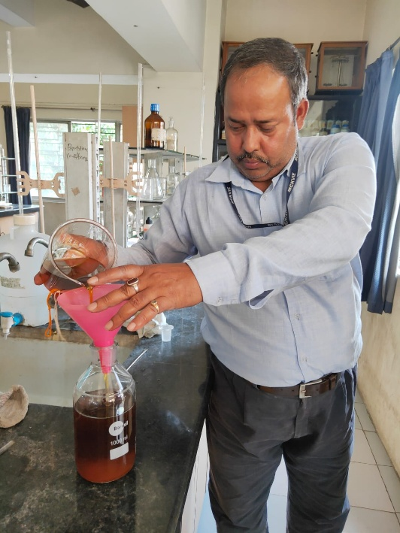
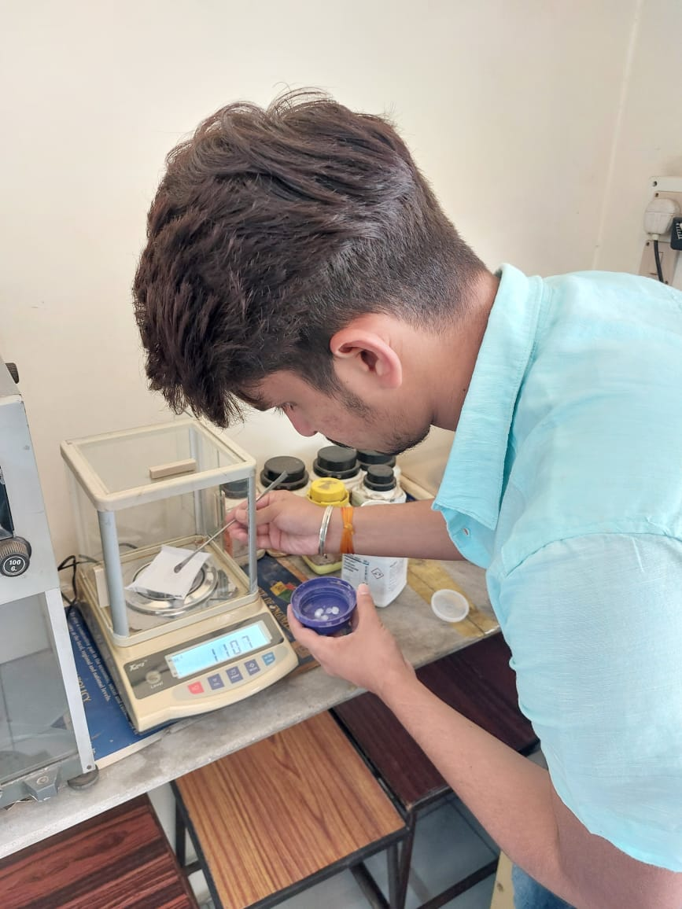
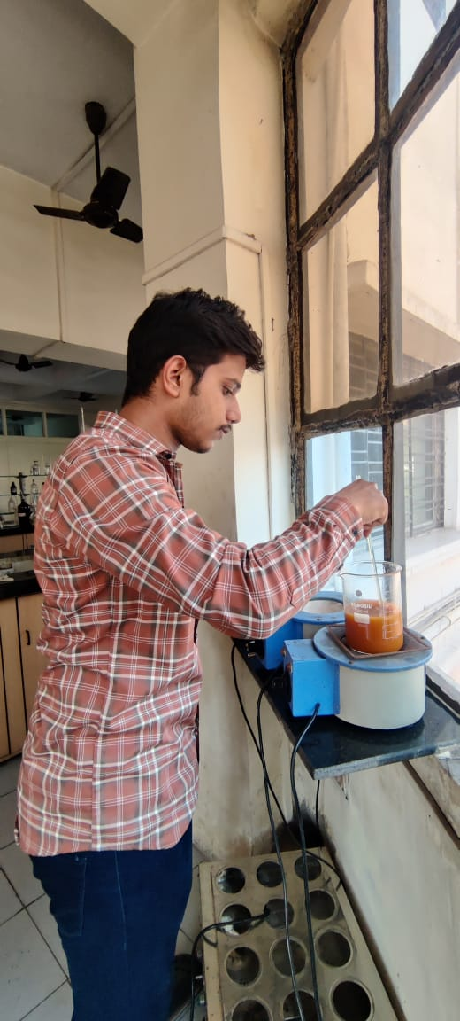
PRESENT WORK
PROCEDURE OF MAKING BIO-DIESEL
Step 1:- Filtration and Storing of Waste Cooking oil.
The raw waste cooking oil (Palm Oil) was taken and filtered using a cloth to remove the impurities present. The filtered oil was stored in a large glass bottle.
Step 2:- Preparation of Samples.
A total of 4 samples were produced using different proportions of waste cooking oil( Palm oil) and Methanol using the process of Transesterification using Sodium hydroxide as a catalyst.
Sample 1- Palm Oil(40ml)+ Methanol(60ml) + Catalyst NaOH (5mg) mixed in distilled water.
Sample 2- Palm Oil(50ml)+ Methanol(50ml) + Catalyst NaOH (5mg) mixed in distilled water.
Sample 3- Palm Oil(60ml)+ Methanol(40ml) + Catalyst NaOH (5mg) mixed in distilled water.
Sample 4- Palm Oil(70ml)+ Methanol(30ml) + Catalyst NaOH (5mg) mixed in distilled water.
Filtration
Storing of Filtered oil
Weight measurement of Catalyst
Heating of mixture

Slide 9
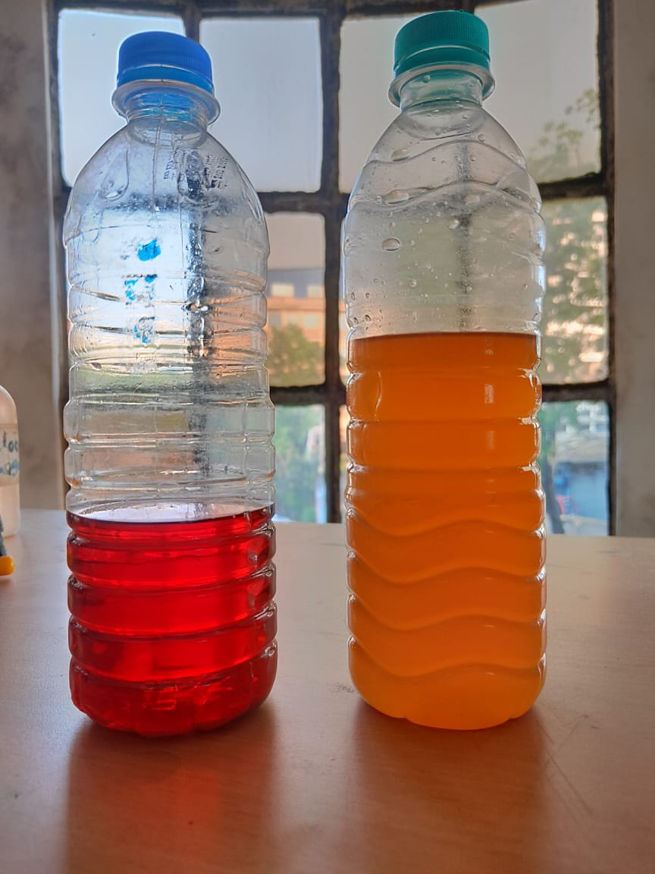
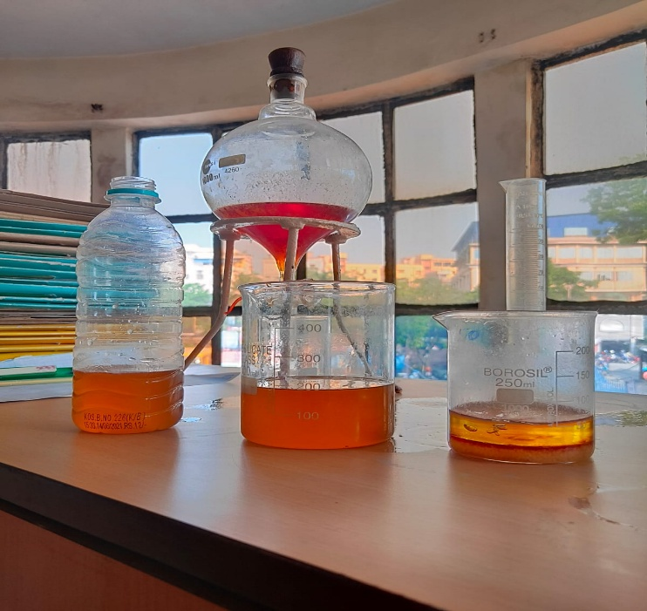
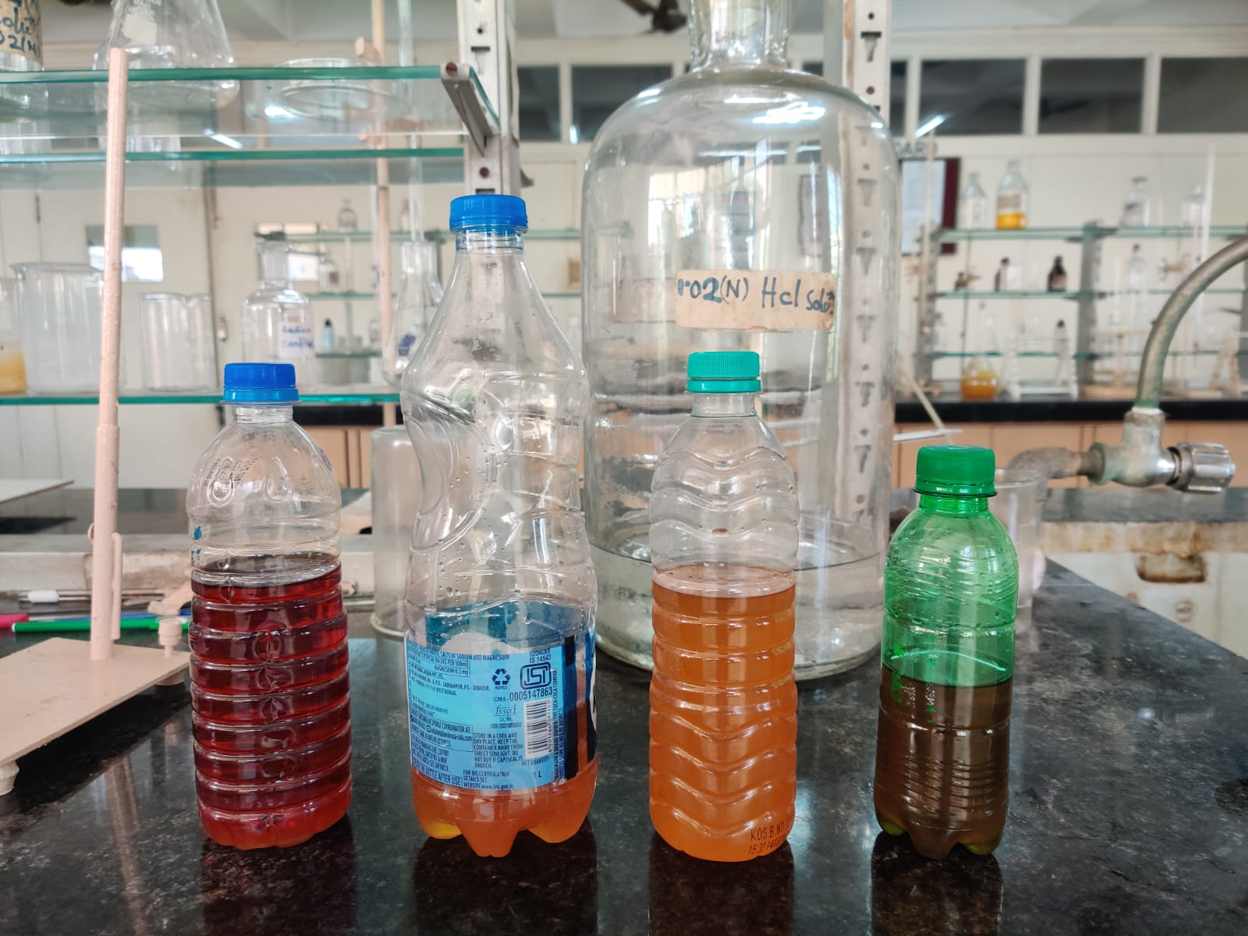
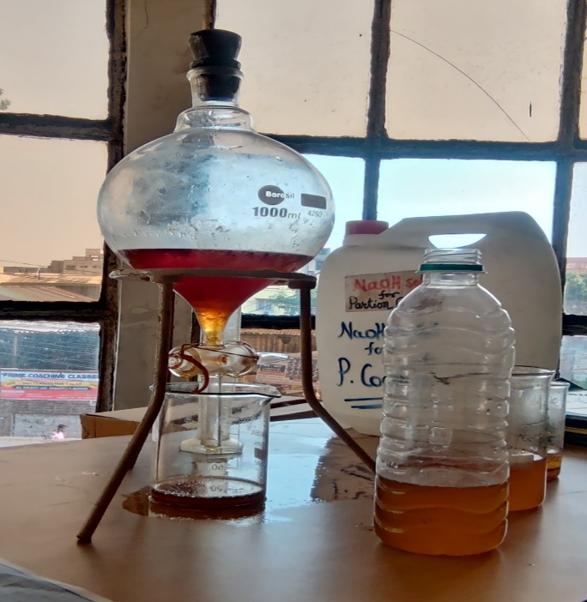
PRESENT WORK
Step 3:- Separation of Bio-Diesel
After 24hours 2 clear layers can be seen the top part was composed of free fatty acid methyl esters (BIODIESEL). The bottom deposit was made up of glycerol ,salts ,soap and other impurities. The contents of the beaker were transferred into a separating funnel and allowed to settle. After some time they were separated and kept in two bottles for further testing.

Slide 10
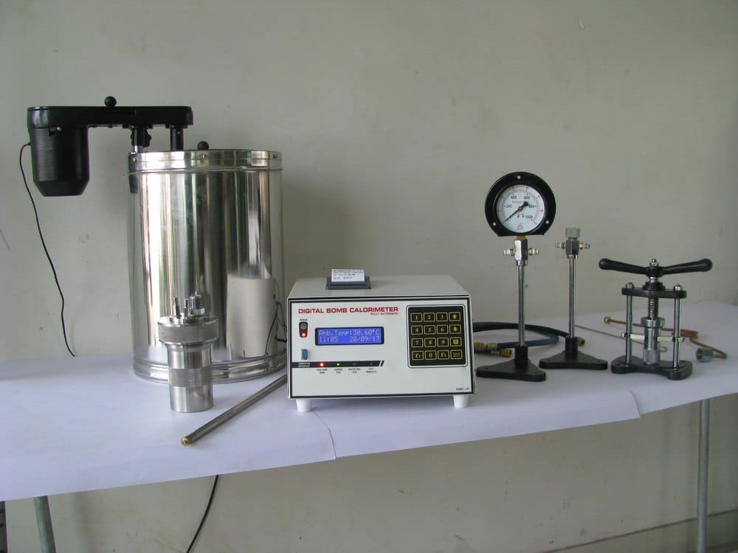
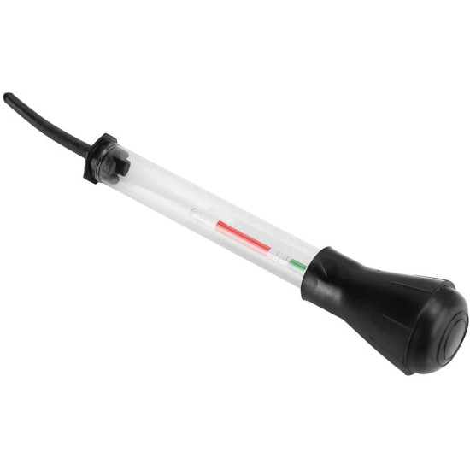
PRESENT WORK
Property Testing
The Calorific value of the prepared bio-diesel was tested using Bomb Calorimeter and the Specific Gravity was calculated using a hydrometer. The Cetane Number of the sample was calculated in a lab.
Calorific Value of Sample - 8145 kcal/kg = 34078 kJ/kg.
Cetane Value of Sample- 49.
Specific Gravity of Sample: 0.8610.
BOMB CALORIMETER
HYDROMETER

Slide 11
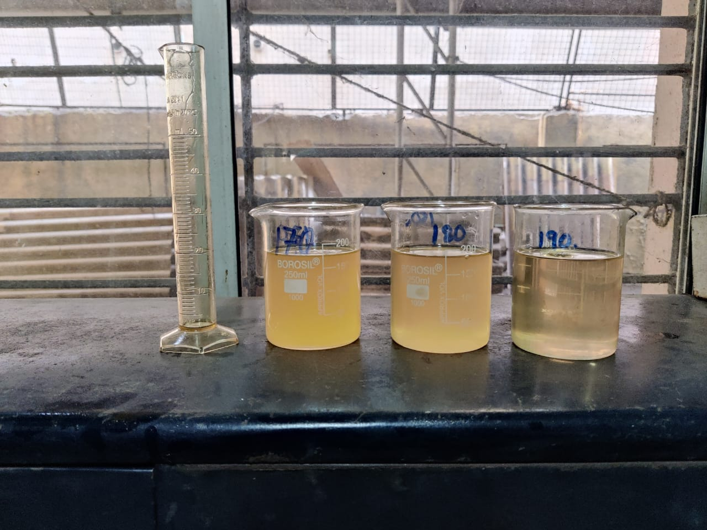
PRESENT WORK
BLENDING WITH DIESEL
The biodiesel sample was mixed with diesel in different proportions to prepare three different test samples.
Sample 1- B05 - Diesel((190ml) + Biodiesel(10ml)
Sample 2- B10 - Diesel((180ml) + Biodiesel(20ml)
Sample 3- B15 - Diesel((170ml) + Biodiesel(30ml)

Slide 12
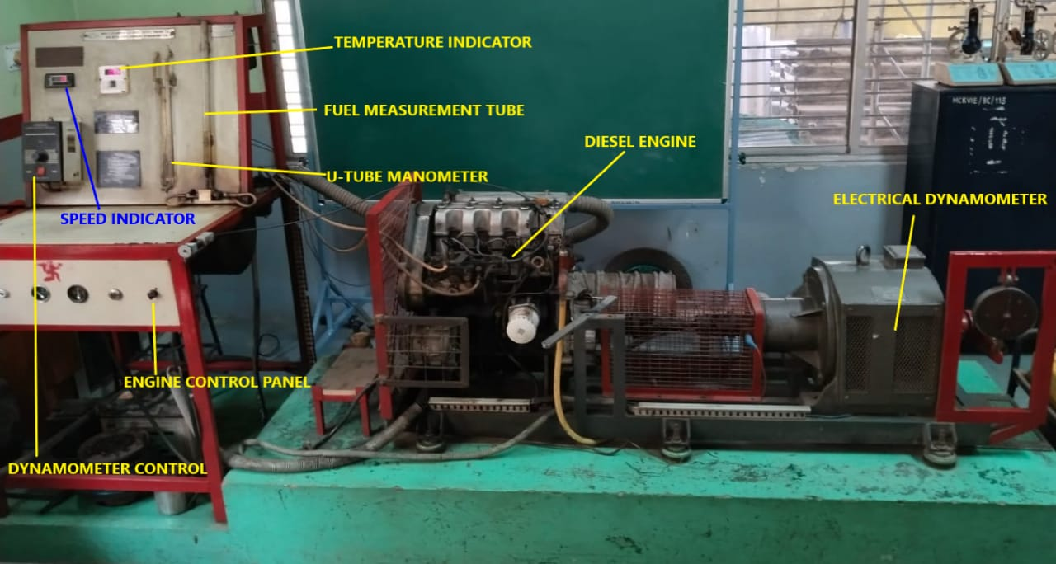
PRESENT WORK
Engine Performance Test:
Formulae Used :
1.Brake Power (BP) = (2πNT / 60000) kW
where N= RPM
T= Wx9.81xAL
where W=Load, AL= Arm Length= 200mm=0.2m
2.Mass of Fuel Consumed (Mf) = (10 x Specific Gravity of diesel x 3600) / (Time x x1000) kg/hr
3.Brake Specific Fuel Consumption (BSFC) = Mf / BP kg/kw-hr
4.Brake Thermal Efficiency () = [ (BP x 3600) / (Mf x CV)] x 100 %
where CV= Calorific Value of Fuel mixture
Engine Specification:-
4Cylinder 4Stroke Diesel Engine.
Bore-75mm, Stroke- 79mm.
Power- 64bhp@5000rpm. Displacement-1396cc.
Loading : Eddy Current Dynamometer (Arm Length = 200mm).

Slide 13
RESULTS AND DISCUSSION
B-05(5% Bio diesel +95% Diesel)
SL NO. | UNITS | 1 | 2 | 3 | 4
LOAD | Kg | 16 | 19 | 19 | 22
RPM | Rpm | 1500 | 1300 | 1700 | 1500
10cc Fuel flow time | Sec | 20.44 | 19.66 | 15.13 | 15.63
Exhaust Temp. | degree C | 208 | 228 | 251 | 275
SFC | kg/kW- hr | 0.3012 | 0.3043 | 0.3024 | 0.2865
BP | kW | 4.933 | 5.076 | 6.639 | 6.782
BTE | Percentage | 27.46 | 27.18 | 27.36 | 28.87

Slide 14
RESULTS AND DISCUSSION
B-10(10% Bio- Diesel+90% Diesel)
B-15(15% Bio-diesel+85% Diesel)
SL NO. | UNITS | 1 | 2 | 3 | 4
Load | Kg | 16 | 16 | 19 | 22
RPM | rpm | 1300 | 1700 | 1500 | 1700
10CC Fuel flow time | Sec | 22.56 | 17.22 | 18.10 | 14.06
Exhaust temp. | Degree C | 223 | 242 | 258 | 286
SFC | Kg/kW-hr | 0.3153 | 0.3159 | 0.2868 | 0.2813
BP | KW | 4.275 | 5.590 | 5.857 | 7.687
BTE | Percentage | 26.54 | 26.49 | 29.18 | 29.74
SLNO. | UNITS | 1 | 2 | 3 | 4
Load | Kg | 16 | 19 | 19 | 22
RPM | Rpm | 1500 | 1300 | 1700 | 1500
10CC Fuel flow time | Sec | 20.03 | 20.15 | 15.46 | 15.60
Exhaust temp. | Degree C | 223 | 235 | 251 | 272
SFC | Kg/kW-hr | 0.3081 | 0.2976 | 0.2966 | 0.2877
BP | Kw | 4.933 | 5.076 | 6.639 | 6.782
BTE | Percentage | 27.48 | 28.45 | 28.54 | 29.43

Slide 15
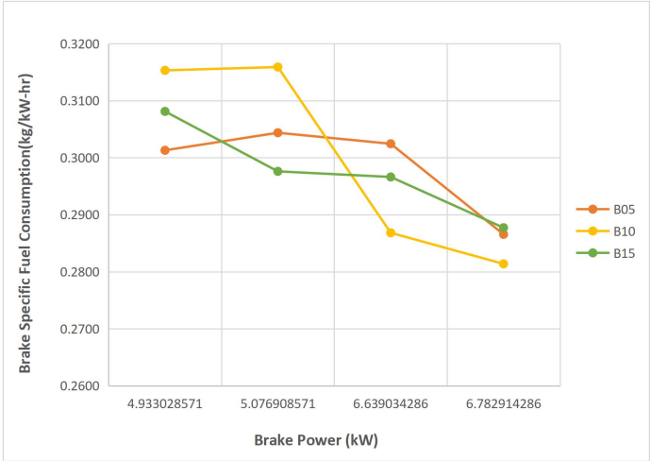
COMPARISON OF PERFORMANCE
BSFC VS BP

Slide 16
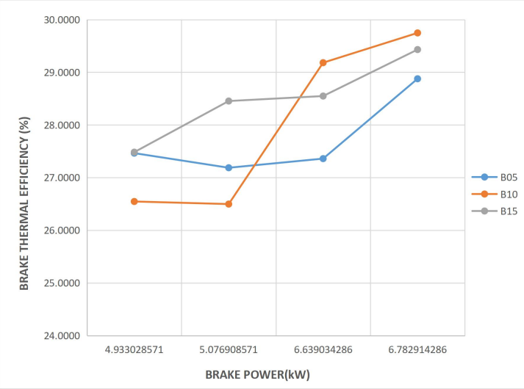
COMPARISON OF PERFORMANCE
BRAKE THERMAL EFFICIENCY VS BP

Slide 17
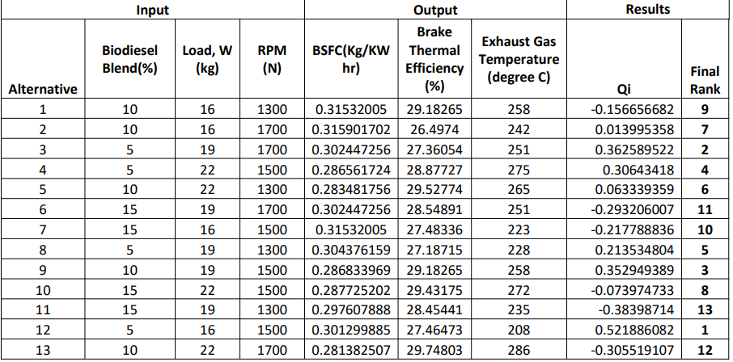
FINAL TABLE AFTER OPTIMIZATION

Slide 18
CONCLUSION
According to the optimization tool it has been found that at 5% blend , 16kg load and 1500rpm the engine gives best results therefore it has been denoted as rank one.
Biodiesel can easily replace conventional diesel when used in 15% blend without any modification of engine.
Biodiesel properties improve on high loads. 15% blended biodiesel can decreases heat input as compared to normal diesel.
Fuel consumption is almost similar to normal diesel at heavy loads.. Biodiesel can minimize the heat loss from exhaust gas.
FUTURE SCOPE OF WORK
Due to unavailability of the pollution testing machine we were unable to measure the engine emission standards by using our own prepared bio-diesel. So, in future we will conduct the engine emission test in which Exhaust gas analyzer would be used to calculate the values like, Hydrocarbon (HC), Monoxide of Carbon (CO) and NO_{x} and check for reduction in emissions as compared to normal diesel.

Slide 19
REFERENCES
[1]X. Chen et al., “Optimisation of the conversion of waste cooking oil into biodiesel,” Strathclyde Institute of Pharmacy and Biomedical Sciences, University of Strathclyde, The John ArbuthnottBuilding, 27 Taylor Street, Glasgow, G4 0NR, Scotland.
[2]^ Piyanuch Nakpong , Sasiwimol Wootthikanokkhan (2009),’ Optimization of biodieselproduction from Jatropha curcas L. oil via alkali-catalyzed methanolysis’.
[3] ^ S.L.Sinha ,R.K.Yadav (2010)’ Performance of diesel engine using blends of conventional diesel and jatropha biodiesel as alternative fuel for clean environment’, International Journal for Research InEmerging Science And Technology, Volume 2, Issue 2, Feb 15, pp 8-15 (E-ISSN 2349-7610).
[4]^ Hamed M. El-Mashad et al. (2008),’ A two-step process for biodiesel production from salmon oil’.
[5]^ P.K. Sahoo et. al.(2006),’ Biodiesel development from high acid value polanga seed oil and performance evaluation in a CI engine’.
[6]^ Daniela Russi(2008) , ‘An integrated assessment of a large-scale biodieselproduction in Italy: Killing several birds with one stone?’

Slide 20
THANK YOU

